Slide 1

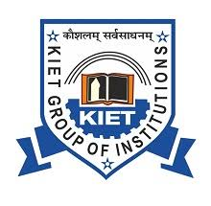
KIET GROUP OF INSTITUTIONS GHAZIABAD, UTTAR PRADESH (Affiliated to Dr A. P. J. Abdul Kalam Technical University, Lucknow) Department of Computer Science Session 2024-25
DESIGNING A CHATBOT TO STRENGTHEN RIVER COMMUNITIES USING AI CHATBOT
Project ID :- PCS25-29
Team Members:-
Yash Tiwari (2100290120197)
Yash Vardhan Singh (1900290120198)
Vatsal Mishra (2100290120187)
Vansh Singhal (2100290120184)
Guided by:-
Prof. Vivek Kumar Sharma

Slide 2
Problem Statement
Addresses the lack of real-time information and engagement in river communities by designing an AI-powered chatbot to enhance awareness, communication, and resilience.

Slide 3
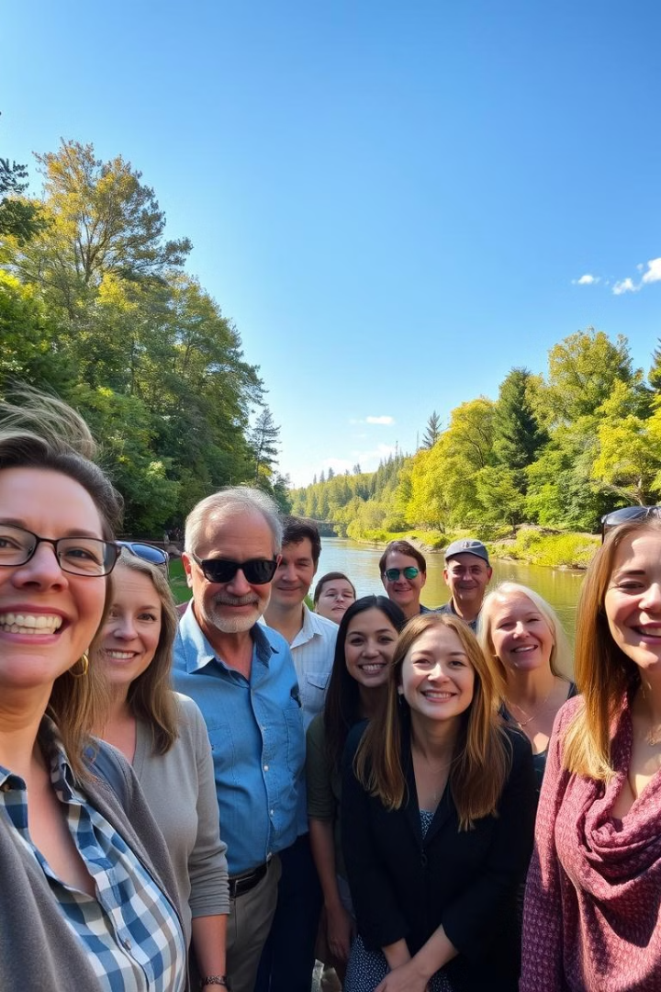
Project Goals and Objectives
Provide real-time and location-specific information: The chatbot will deliver timely updates on river water levels, weather conditions, and flood alerts, helping communities stay informed and safe.
Improve communication and coordination: It will act as a bridge between local authorities, NGOs, and residents, enabling smooth information flow and emergency coordination.
Raise awareness and educate users: The chatbot will share information on river pollution, conservation techniques, and best practices for sustainable water use.
Community Engagement and Resource Distribution: Created an AI chatbot that can provide community members with instant assistance and resources. The chatbot is able to both listen for relevant information and give back helpful suggestions and answers based on what it hears.
Data Analytics: Merge and analyse data from community encounters to find out river communities unique needs and trends. It means in practice identifying patterns of resource demands among different user groups; places where people do not communicate with each other at all environment-related matters that we could be giving closer attention to next year.

Slide 4
SDG Goals
SDG 6: Clean Water and Sanitation
Promotes awareness and responsible use of water resources through education and real-time updates.
SDG 11: Sustainable Cities and Communities
Enhances resilience and disaster preparedness of river communities through timely alerts and communication.
SDG 13: Climate Action
Supports adaptation to climate-related hazards by providing environmental data and safety guidelines.
SDG 9: Industry, Innovation and Infrastructure
Utilizes AI-driven digital innovation to improve infrastructure for communication and knowledge sharing.

Slide 5
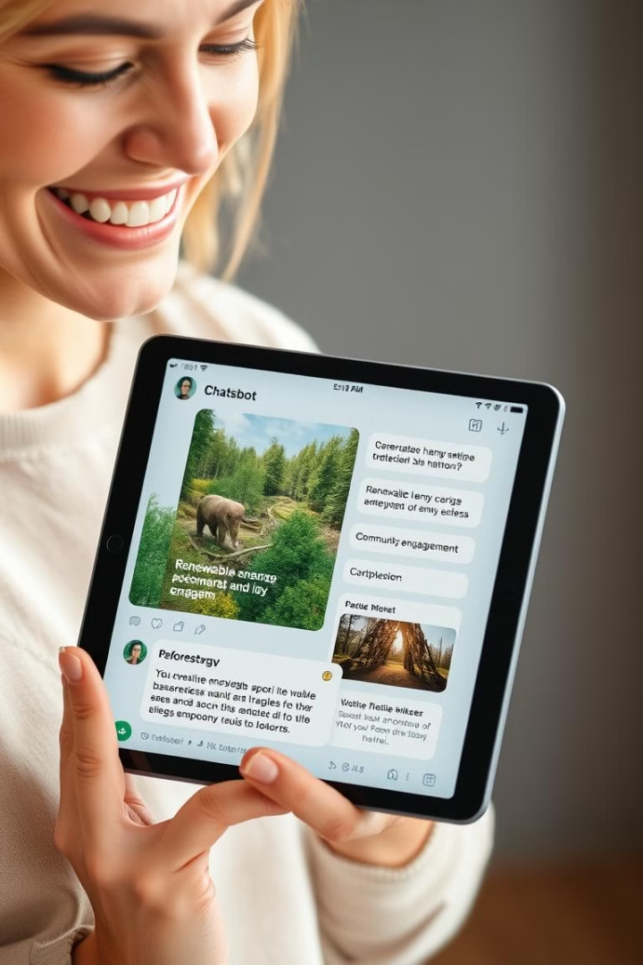
Technology Used
Python
JavaScript
Node.js
TypeScript
Cloud Certifications
APIs
NumPy / Pandas

Slide 6
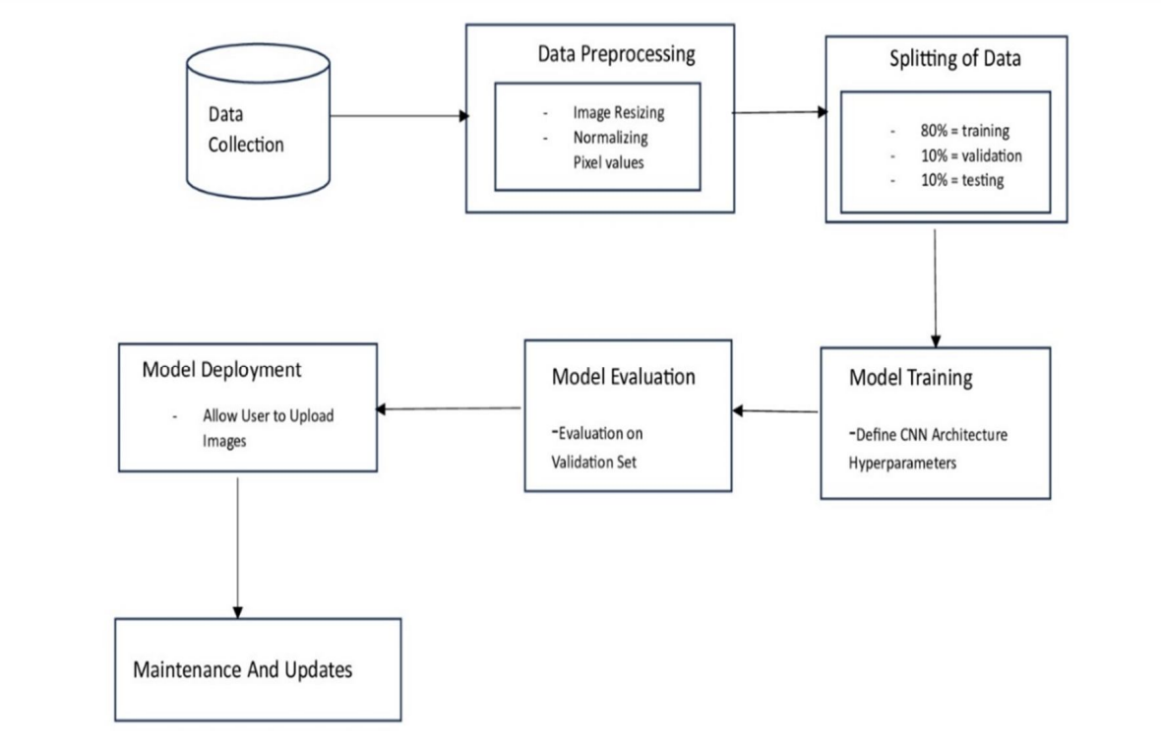
Workflow Diagram

Slide 7
Methodology
Data Collection
Collected textual data related to river conditions, flood alerts, environmental guidelines, and community FAQs from government portals, NGOs, and verified open data sources to build a rich knowledge base for the chatbot.
Data Annotation
Annotated the collected data by categorizing it into intents (e.g., flood alert, water level status, conservation tips) and entities (e.g., river names, locations, dates) to train the Natural Language Understanding (NLU) module effectively.
Preprocessing
Cleaned and structured the text data by removing duplicates, correcting grammar, and standardizing terminology. Preprocessing also included tokenization and lemmatization to enhance model comprehension and performance.
Model Development
Developed an AI-powered chatbot using NLP frameworks like Rasa or Dialogflow, with a focus on intent classification, entity recognition, and context handling to ensure meaningful and context-aware conversations with users.
Model Optimization
Fine-tuned the chatbot using user feedback and conversation logs. Techniques like intent confidence tuning, fallback mechanisms, and response variation were applied to make the chatbot more accurate, responsive, and human-like.
Interface Development
Built a user-friendly web-based interface where users can interact with the chatbot. The interface includes features like multi-language support, voice-to-text input, and accessibility for mobile devices to ensure inclusivity.
Deployment (Local)
Integrated and deployed the chatbot on a local server or device to allow offline usage in remote river communities with limited internet connectivity. This ensures uninterrupted access to vital information during emergencies.

Slide 8
Expected Outcomes
Increased Access to Real-Time Information River communities will have immediate access to updates on weather, water levels, and emergencies, helping them make informed decisions.
Improved Disaster Preparedness and Response
The chatbot will enhance community readiness by providing early warnings and emergency instructions, reducing the impact of floods and other disasters.
Greater Awareness of Sustainable Practices
Residents will gain knowledge about pollution control, water conservation, and river ecosystem protection, leading to more environmentally conscious behavior.
Reduced Information Gaps in Remote Areas Even remote or underserved communities will benefit from easily accessible, multilingual chatbot services via mobile or messaging apps.

Slide 9
Literature Survey
Title: "Community Development and Environmental Management using AI Chatbots"
Authors: R. Gandhi, S. Patel, A. Prakash, M. Gupta
Title: "Social Presence and Trust in Human-Chatbot Interaction"
Authors: A. Short, J. Burgoon, H. Nass, L. Liu

Slide 10
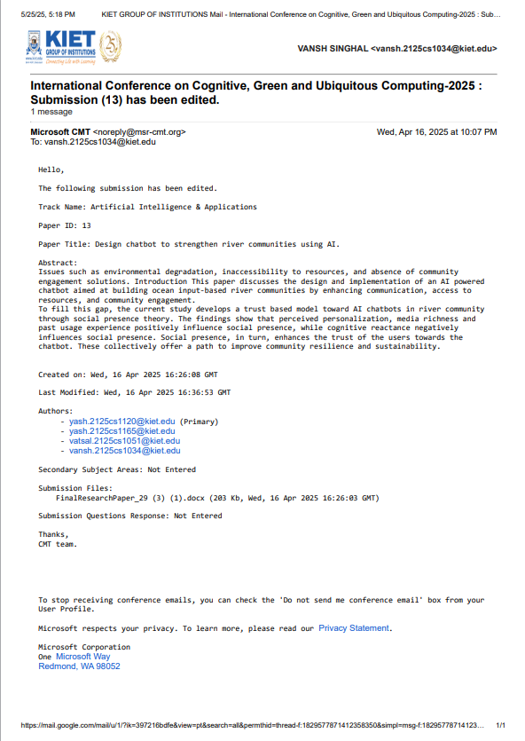
Research Paper Status
Submitted

Slide 11
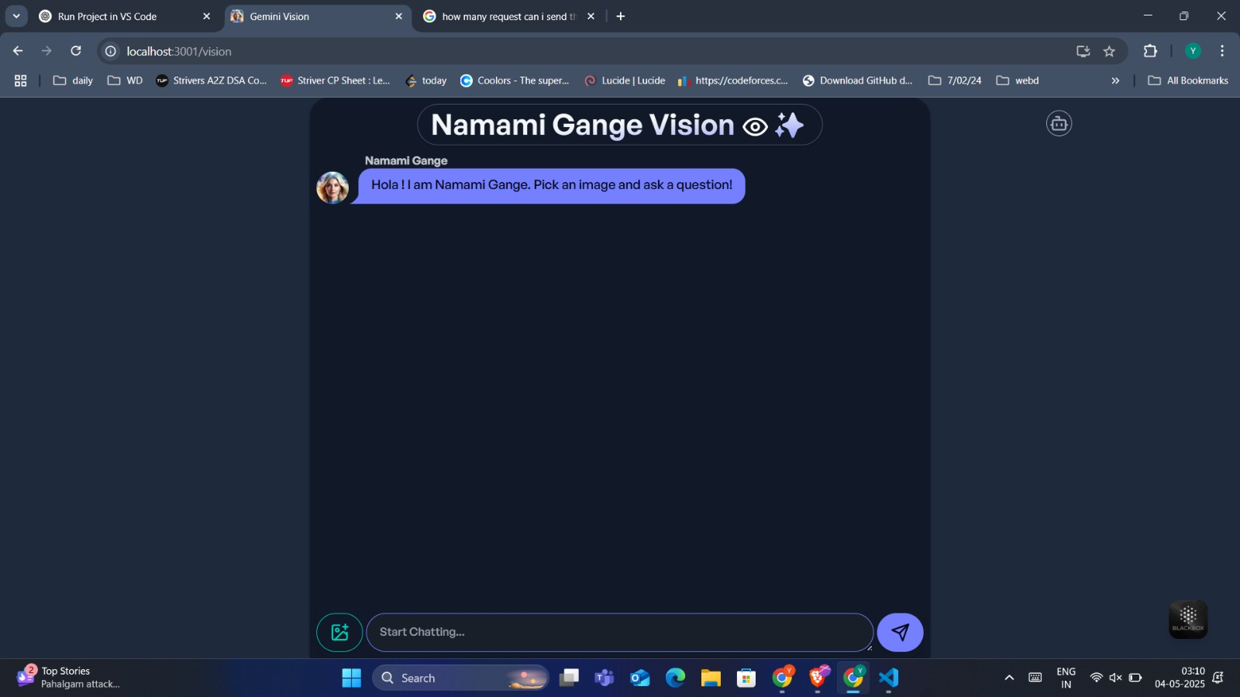
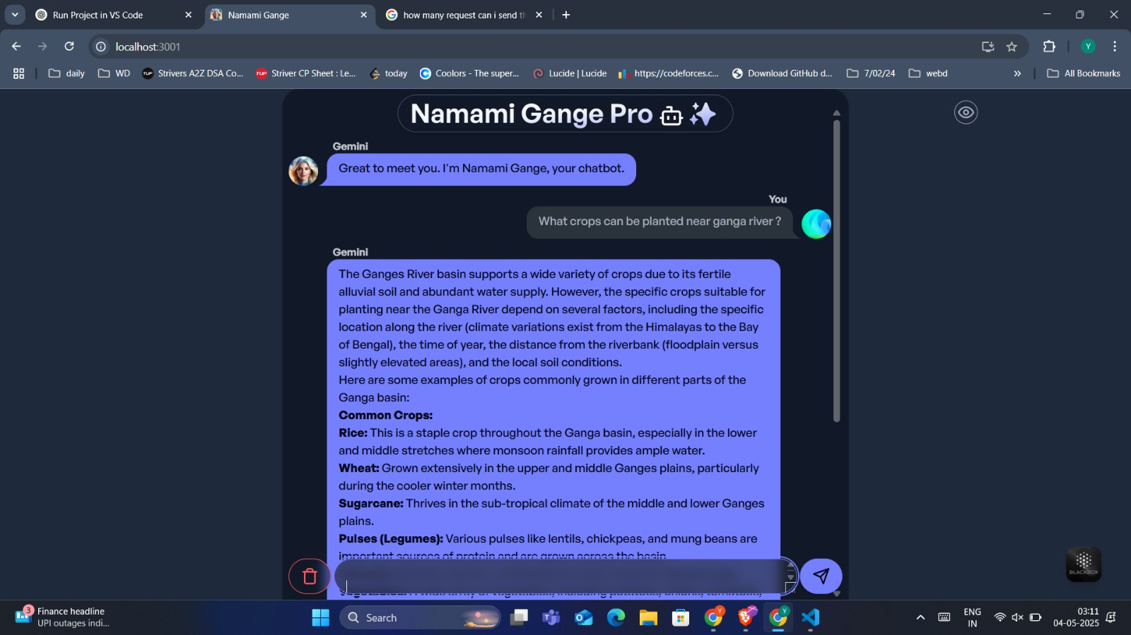
Project Status
Completed

Slide 12
References
Kumar, R. et al. (2020). "AI-Driven Agricultural Chatbots: A Case Study in Rural India." IEEE Transactions on Sustainable Computing.
UNICEF. (2021). "U-Report: Real-Time Crisis Engagement in Low-Resource Settings."
Devlin, J. et al. (2018). "BERT: Pre-training of Deep Bidirectional Transformers for Language Understanding." NAACL.

